Slide 1
Introduction
Databases and Database Systems

Slide 2
What is Database ?
An organized collection of related data.
Example of Database Systems
a telephone book
T.V. Guide
airline reservation system
motor vehicle registration records
papers in your filing cabinet
files on your computer hard drive

Slide 3
Basic Definitions
Data:
Facts that can be recorded and have an implicit meaning.
Mini-world:
Some part of the real world about which data is stored in a database. For example, University.
Database Management System (DBMS):
A software system to facilitate the creation and maintenance of a computerized database.
Database System:
DBMS together with the data.
Sometimes, the applications are also included

Slide 4
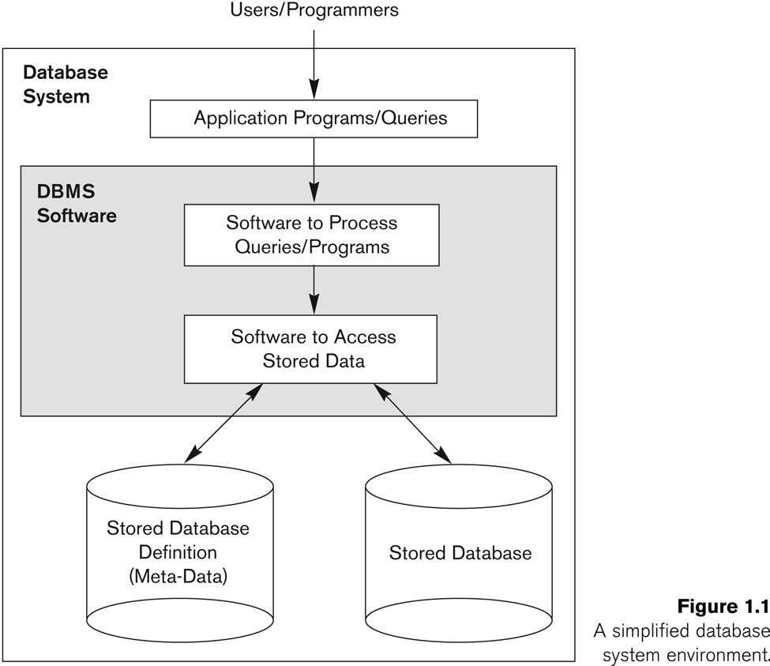
Simplified database system environment

Slide 5
Example of a Database
Mini-world: UNIVERSITY
Some mini-world entities:
STUDENTs
COURSEs
SECTIONs (of COURSEs)
DEPARTMENTs
INSTRUCTORs
Some mini-world relationships:
SECTIONs are of specific COURSEs
STUDENTs take SECTIONs
COURSEs have prerequisite COURSEs
INSTRUCTORs teach SECTIONs
COURSEs are offered by DEPARTMENTs

Slide 6
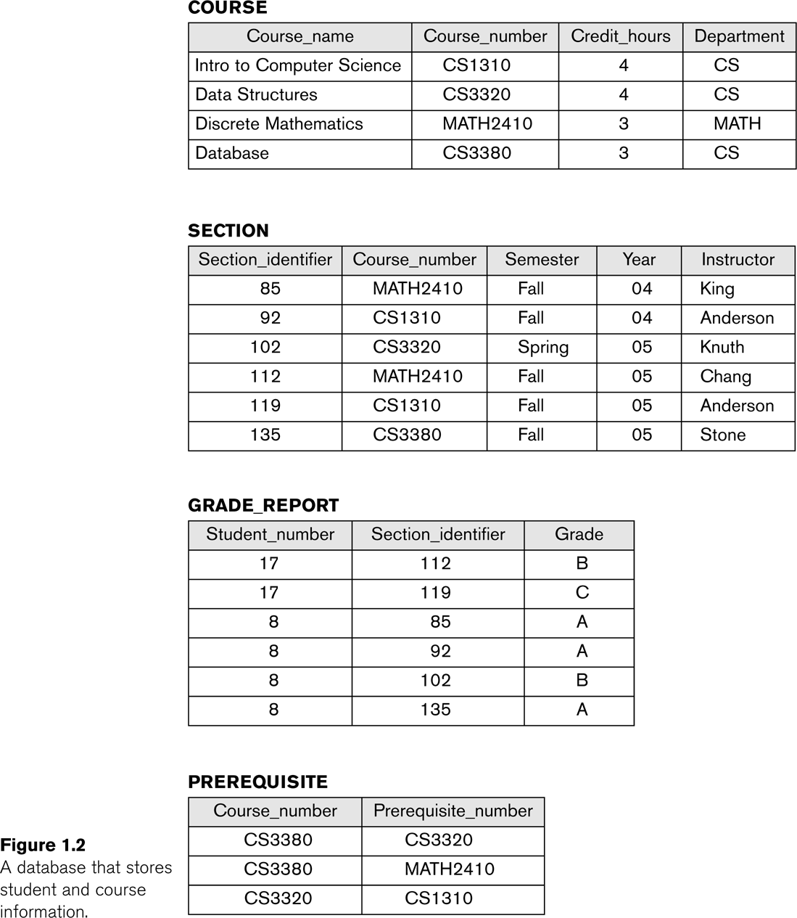
Example of a simple database

Slide 7
Drawbacks of using file systems to store data
Data redundancy and inconsistency
Multiple file formats, duplication of information in different files
Difficulty in accessing data
Need to write a new program to carry out each new task
Data isolation — multiple files and formats
Integrity problems
Integrity constraints (e.g. account balance > 0) become part of program code
Hard to add new constraints or change existing ones

Slide 8
Drawbacks of using file systems to store data
Atomicity of updates
Failures may leave database in an inconsistent state with partial updates carried out
E.g. transfer of funds from one account to another should either complete or not happen at all
Concurrent access by multiple users
Concurrent accessed needed for performance
Uncontrolled concurrent accesses can lead to inconsistencies
E.g. two people reading a balance and updating it at the same time
Security problems

Slide 9
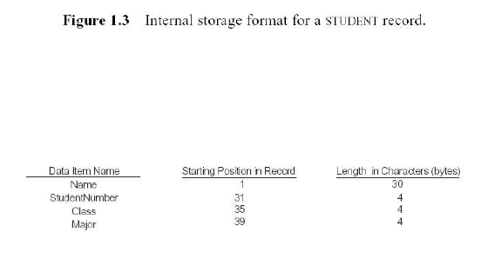
Characteristics of the Database Approach
Data Abstraction:
Data model is used to hide storage details and present the users with a conceptual view of the database.
Programs refer to the data model constructs rather than data storage details.

Slide 10
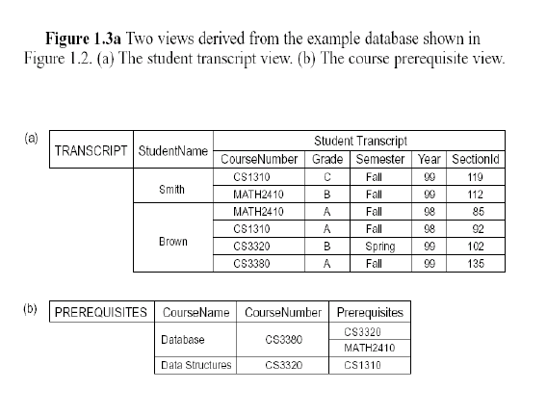
Characteristics of the Database Approach
Support multiple views of the data:
Each user may see a different view of the database, which describes only the data of interest to that user.

Slide 11
Advantages of DBMS
Control redundancy
Data Sharing
Restrict unauthorized access
Provide Storage Structures (e.g. indexes for efficient Query Processing)
Backup and recovery services
Multiple interfaces for different classes of users
Enforce integrity constraints on the database
Notes:
Post-lab: Install SQL, make DB model of FAST-NU tables include Department, Instructor, Student, Course.

